Slide 1

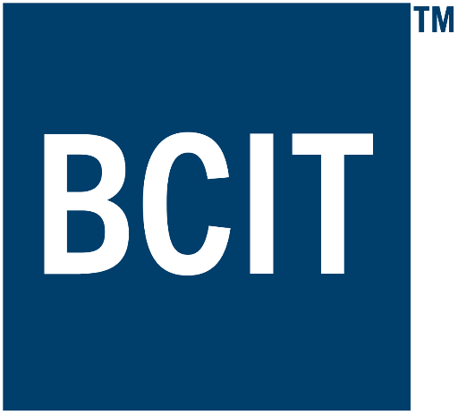
Applied Virtual Networks
COMP 4912
Instructor: Dawood Sajjadi
PhD, SMIEEE, CISSP
ssajjaditorshizi@bcit.ca
Winter-Spring 2025
Week #4

Slide 2
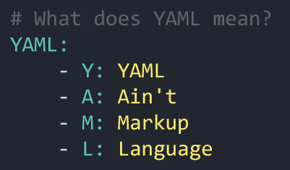
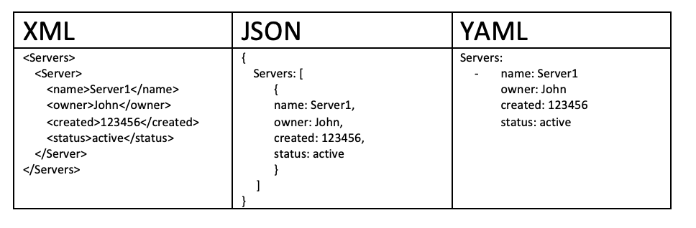
YAML Intro
RECAP
YAML is a human-readable data-serialization format.
Commonly used for configuration files in Cloud Applications.
YAML is designed to be friendly to people working with data and achieves "unique cleanness" by minimizing the use of structural characters, allowing the data to appear in a natural and meaningful way.
YAML achieves easy inspection of data's structures by using indentation-based scoping (similar to Python).

Slide 3
Docker Compose and YAML
RECAP
Setup a web server using Nginx and a static HTML website served from a local directory.
This example demonstrates key Docker Compose concepts like defining services, volumes, and ports.
docker-compose.yml
Index.html
version: '3.9'
services:
web:
image: nginx:latest
ports:
- "8080:80" # Map port 8080 on the host to port 80 in the container
volumes:
- ./html:/usr/share/nginx/html:ro # Mount the local html/ directory to Nginx's web root
<!DOCTYPE html>
<html lang="en">
<body>
<h1>Welcome to My Simple Website!</h1>
<p>Served using Docker Compose with Nginx.</p>
</body>
</html>
$ docker-compose up -d --build
Access your website via http://localhost:8000
Notes:
docker-compose up --build to define/run multi-container applications

Slide 4
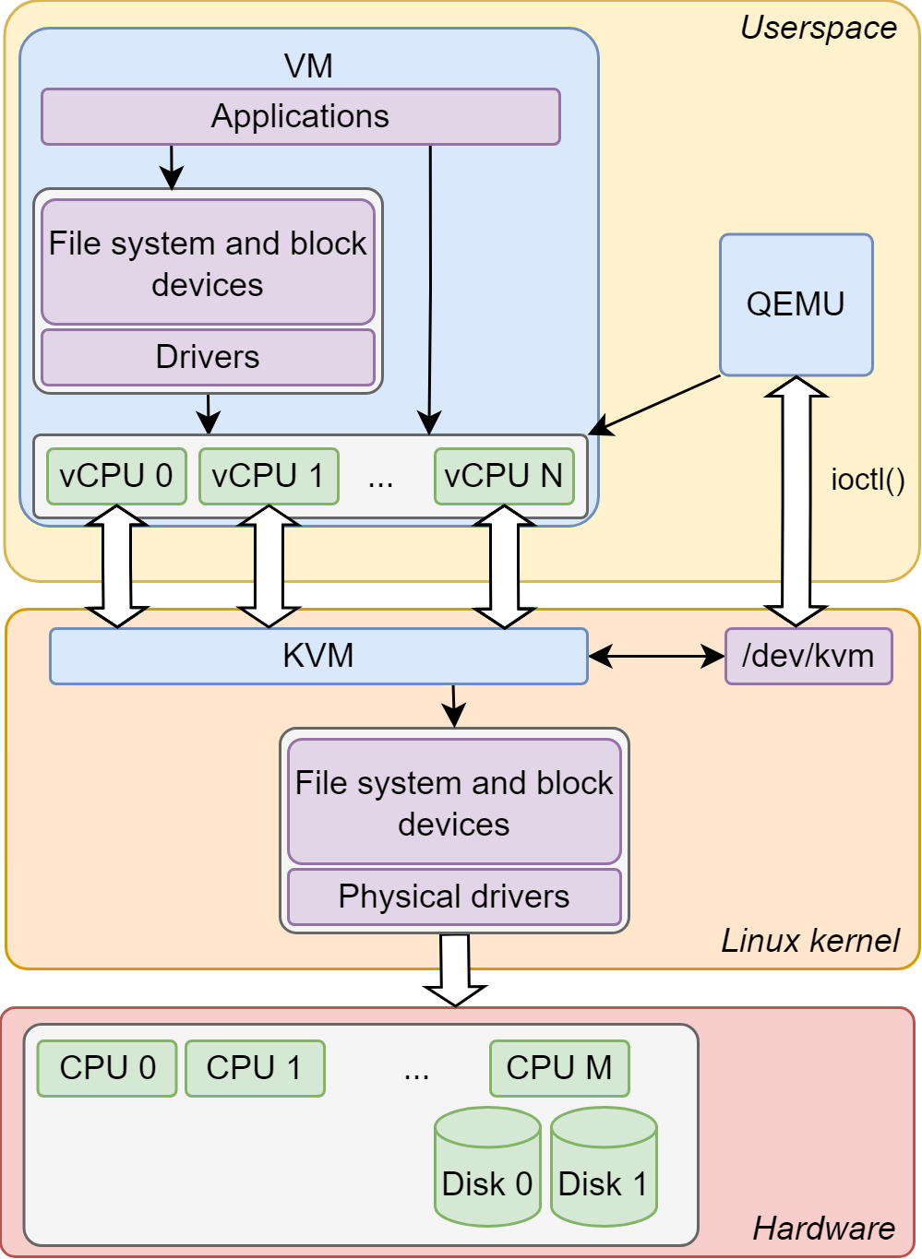
KVM (Kernel-based Virtual Machine)
RECAP
KVM is the lowest component in the stack and as a Linux kernel module, interacts directly with the hardware.
It makes use of hardware-assisted virtualization supported by the CPU, in order to allow Hardware-based Full Virtualization.
QEMU sits above KVM and complements its functionality.
QEMU manages the processes of the guest systems and emulates devices being passed to them.
Libvirt is the library that is used in order to control QEMU and manage the Virtual Machines (VMs).

Slide 5

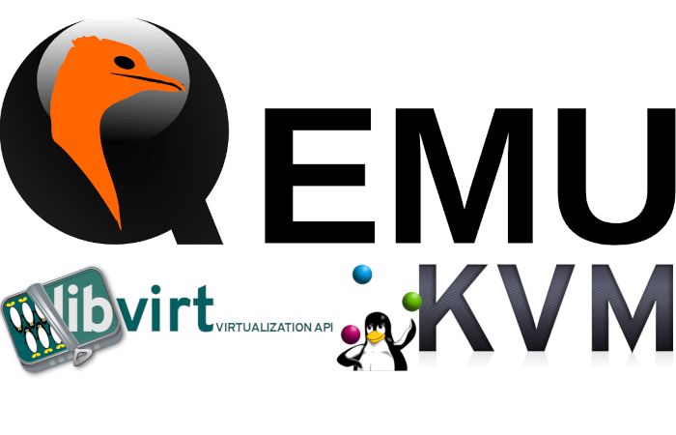
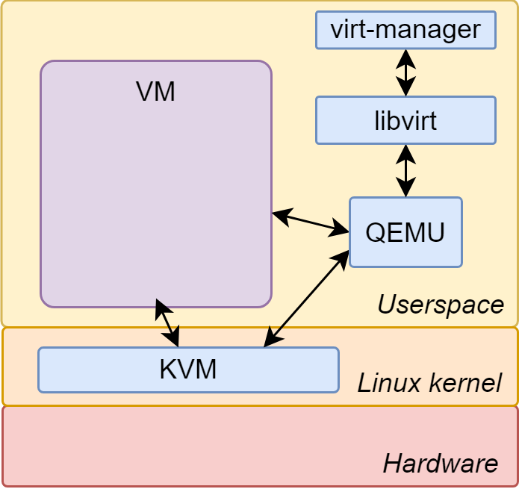
Virsh (Virtual Shell)
RECAP
Virsh is a command-line interface for managing VMs that are handled by the libvirt library. It acts as a management layer on top of KVM, QEMU, or other hypervisors.
Virsh communicates with the libvirt daemon (libvirtd), which interfaces with virtualization back-ends like KVM/QEMU, or LXC. It provides a higher-level, user-friendly way to manage VMs.
KEY FEATURES
Manage VMs: start, stop, list, pause, destroy.
Define virtual machines via XML configuration files.
Connect to remote hypervisors.
Works with multiple hypervisors (KVM/QEMU, VMware ESXi, etc.).
Provides more granular control of VMs and their resources.

Slide 6
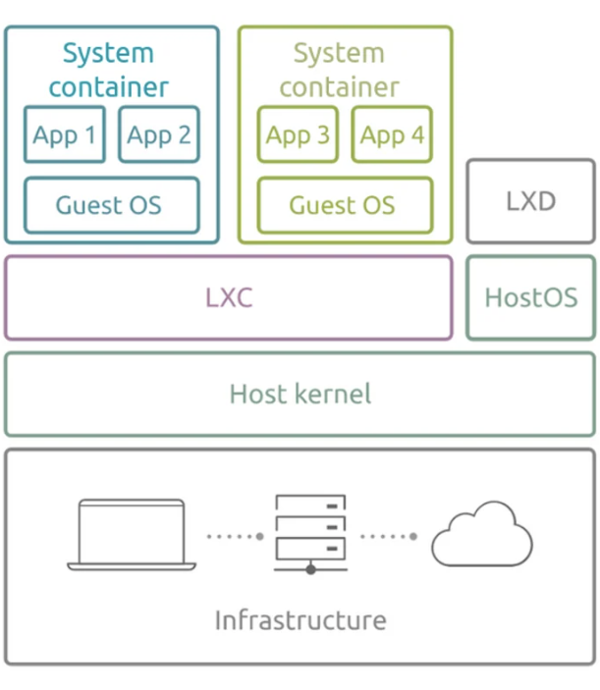
LXC & LXD (LinuX Containers & LinuX Daemon)
RECAP
LXC: Lightweight Containers
enables you to run applications or full Linux distributions in isolated environments without the overhead of full virtualization.
OS-level virtualization.
Containers share the host kernel but run in isolated user spaces.
Fast startup times and low resource overhead.
Ideal for testing or running micro-services.
LXD: A System Container Manager
LXD is a container manager built on top of LXC, designed to provide a simple and easy-to-use interface for managing system containers.
Provides higher-level management features like live migration/snapshots/cloning.
Can manage both containers and virtual machines (using QEMU/KVM).
Supports multi-architecture virtual machines (e.g., x86, ARM).
REST API available for automation and cloud management.
https://documentation.ubuntu.com/lxd/en/latest/explanation/lxd_lxc/
https://canonical.com/lxd

Slide 7
Learning Outcomes of Week #4
1. When/Why we need Container Orchestration?
2. Explain Kubernetes Architecture and its components
3. Describe POD and Core concepts of Kubernetes for service provisioning
4. Explain basic Networking and Storage management in Kubernetes
5. How scaling mechanism works in Kubernetes to handle varying workloads?

Slide 8
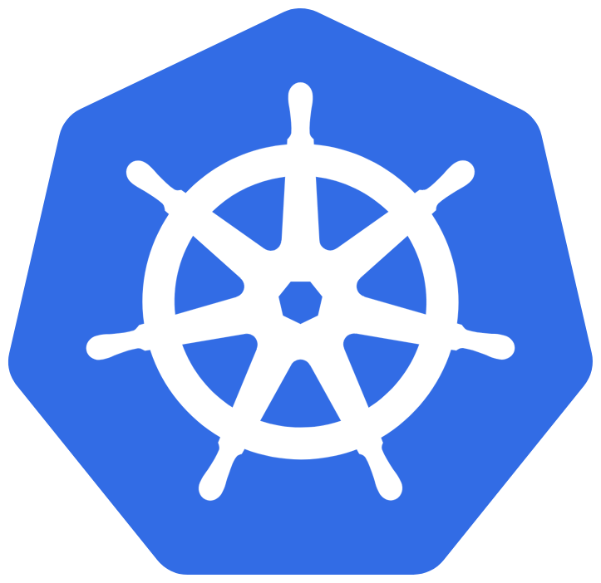
Learning Outcomes of Week #4
Pod
Container Runtime
Deployment
Service
ReplicaSet
ConfigMap
API Server
Kubernetes
Secret
HPA
Scheduler
CNI
etcd
DaemonSet
StatefulSet
Scaling
Kube-proxy
Kubelet
Controller Manager

Slide 9
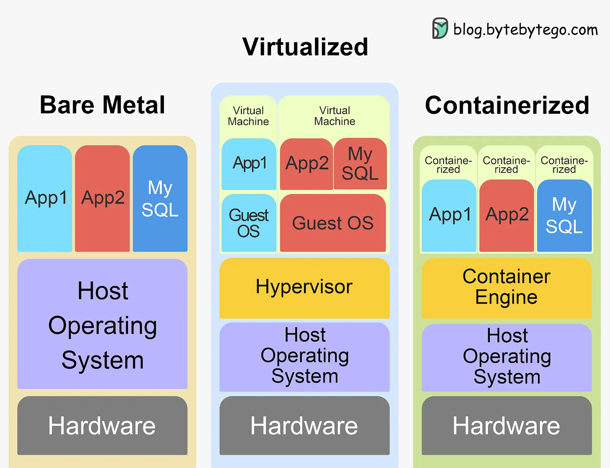
Why Need Kubernetes?

Slide 10



Why Need Kubernetes?
Let’s say you want to build a web site.
The web site should be highly available.
The number of visitors increases over time.
You need to update the site content frequently.
The web site need to automatically scale if needed.
Load Balancer
Docker
Docker
Docker
Docker
Docker
Docker
Kernel
Kernel
Kernel
Kernel
Kernel
Kernel
Host OS
Host OS
Host OS
Host OS
Host OS
Host OS
Hardware
Hardware
Hardware
Hardware
Hardware
Hardware
Worker Nodes

Slide 11
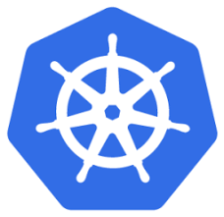

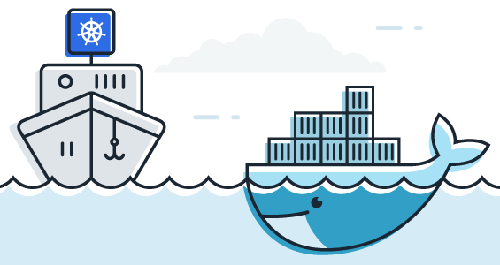
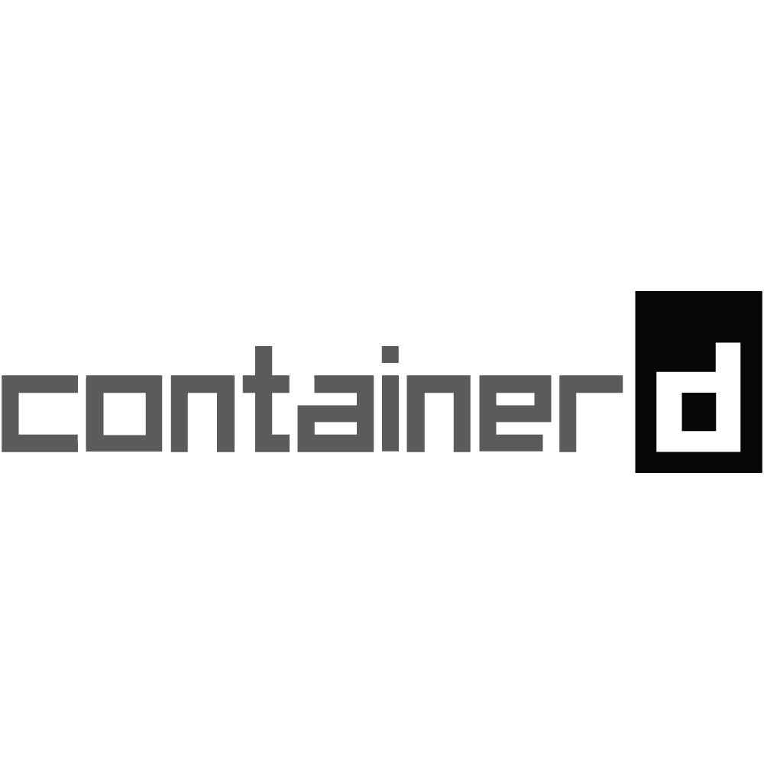
Kubernetes (K8s) is an open-source container orchestration engine that can manage containerized applications.
maintained by the Cloud Native Computing Foundation (CNCF).
Origins at Google (2003–2014):
Inspired by Google’s internal cluster management systems, Borg & Omega.
Provided a foundation for container orchestration best practices.
Open-Sourcing Kubernetes (2014):
Released by Google under the Cloud Native Computing Foundation (CNCF).
Key event that drove community adoption and innovation.
Growth & Community (2015–2019):
Rapid adoption by major cloud providers (AWS, Azure, GCP).
Expanding ecosystem of tools, integrations, and managed K8s services.
Mainstream Adoption (2019–Present):
De facto standard for container orchestration.
Evolving to support advanced use cases (e.g., edge computing, AI/ML workloads).

Slide 12

Why Need Kubernetes?
Applications holy grail:
Developers should not care about Servers, Networking, and Storage
One-click provisioning (Automate Deployment)
High-Availability
Load-Balancing
Auto-Scaling
Apps are easier to deploy but harder to maintain and scale over time.
Apps can be stateful or stateless with different computing, storage, and networking requirements.
Apps are often managed by DevOps teams that have high-level API requirements rather than low-level VM or physical machine requirements.

Slide 13
Why Need Kubernetes?
5 Key Reasons
Simplified App Deployment: all nodes are treated as a single platform, developers don’t need to know anything about the servers.
Simplified App Development: developers and leverage the features mentioned above to create fault-tolerant apps.
Better Hardware Utilization: hardware resources utilization efficiency
Self-Healing via Health Monitoring: Kubernetes monitors both the App and nodes it runs on and automatically reschedules them to other nodes.
Auto-Scaling: based on monitoring, Kubernetes can automatically scale Apps in reaction to load spikes.

Slide 14
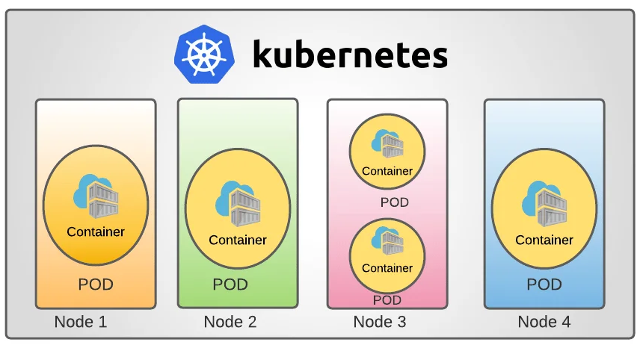
Containers and PODs (Kubernetes Architecture)
The Containers are encapsulated into a Kubernetes object known as PODs.
A POD is the smallest and simplest deployable unit in Kubernetes.
A POD is supposed to be a single instance of an Application.
Pods
have a
One-to-One
relationship with Containers running your Apps.

Slide 15
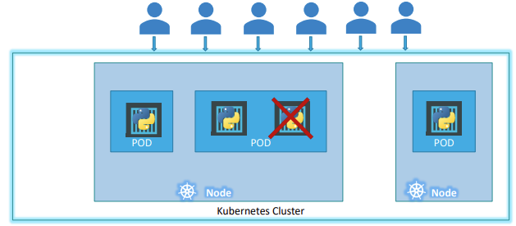
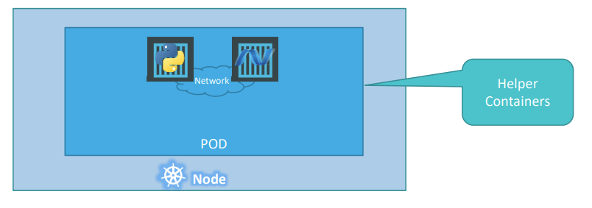
Containers and PODs (Kubernetes Architecture)
Pod is the smallest unit of computation & replication in K8s. If your application needs to scale up, you simply increase number of pods.
Therefore, if you have multiple container running in the same pod and you want just to scale one of them, the other containers will be scaled too which will lead to waste of resources, so have to keep the POD as small as possible (only one process and its helpers)
Pods are ephemeral in nature, when it is deleted it will lose all the state and associated data if it is stored locally. To keep the data, we need to create Persistent Volume Claim.
Multi-Container PODs
NEVER TRY TO SCALE YOUR APP BY ADDING MORE CONTAINERS INTO AN EXISTING POD.
https://kodekloud.com/wp-content/uploads/2020/11/Kubernetes-for-Beginners.pdf
Notes:
What if the number of users accessing your application increase and you need to scale your application? You need to add additional instances of your web application to share the load. Do we bring up a new container instance within the same POD? No! We create a new POD altogether with a new instance of the same application. As you can see we now have two instances of our web application running on two separate PODs on the same k8s system or node. What if the user base FURTHER increases and your current node has no sufficient capacity? Well THEN you can always deploy additional PODs on a new node in the cluster. You will have a new node added to the cluster to expand the cluster’s physical capacity.
Now we just said that PODs usually have a one-to-one relationship with the containers, but, are we restricted to having a single container in a single POD? No! A single POD CAN have multiple containers, except for the fact that they are usually not multiple containers of the same kind. As we discussed in the previous slide, if our intention was to scale our application, then we would need to create additional PODs. But sometimes you might have a scenario were you have a helper container, that might be doing some kind of supporting task for our web application such as processing a user entered data, processing a file uploaded by the user etc. and you want these helper containers to live along side your application container.

Slide 16
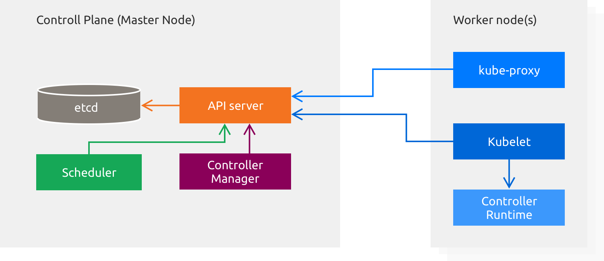


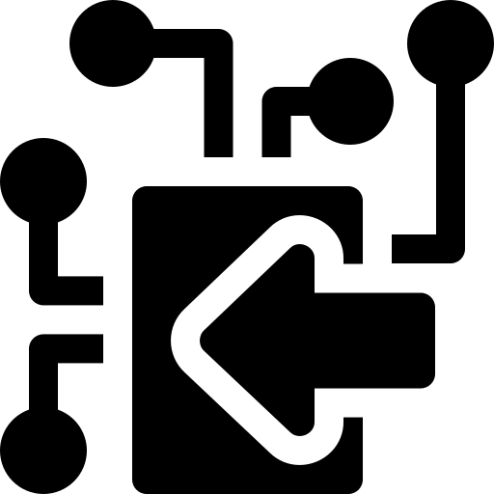
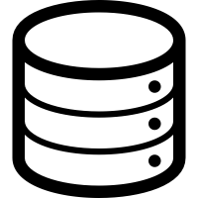
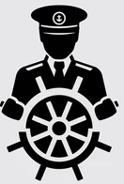


Kubernetes Architecture
Container Runtime
Notes:
Kubernetes nodes: worker nodes (can be VM or physical machines) that maintain multiple running pods and provide Kubernetes’ runtime environment. Main components on worker nodes [need to have at least 3 master nodes in a production grade cluster] 🡪 The reason for using 3 master nodes in a Kubernetes cluster instead of 2 is related to the quorum required for the etcd db, which is a distributed key-value store that holds the cluster's state. In a Kubernetes cluster, etcd uses a Raft consensus algorithm to ensure consistency and fault tolerance. In a Raft-based system, the majority of nodes must agree on the state of the data to commit changes.
etcd: A distributed key-value store that stores the cluster's configuration data and state. Scheduler: Assigns newly created pods to nodes based on available resources and constraints. API Server: Exposes the Kubernetes API and serves as the interface between the user and the cluster. Controller Manager: Ensures desired state of cluster by running controllers that manage resources like replication, scaling & health checks. kube-proxy: Manages network routing for services, enabling communication between pods across nodes. kubelet: An agent running on each node that ensures the containers in the pod are healthy and running as expected (the Capitan of the cluster) Controller Runtime: A library for writing Kubernetes controllers, allowing the automation of complex tasks like deployment and scaling.

Slide 17
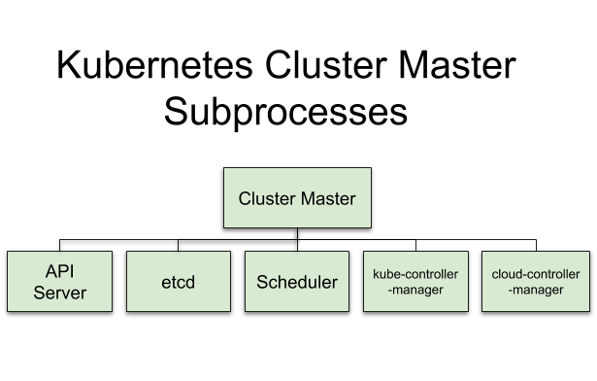
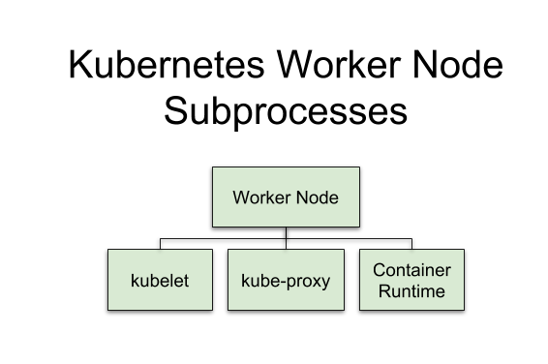
Kubernetes Architecture
Master Node Sub-processes
Worker Node Sub-processes
Notes:
Kubernetes nodes: worker nodes (can be VM or physical machines) that maintain multiple running pods and provide Kubernetes’ runtime environment. Main components on worker nodes
etcd: A distributed key-value store that stores the cluster's configuration data and state. Scheduler: Assigns newly created pods to nodes based on available resources and constraints. API Server: Exposes the Kubernetes API and serves as the interface between the user and the cluster. Controller Manager: Ensures desired state of cluster by running controllers that manage resources like replication, scaling & health checks. kube-proxy: Manages network routing for services, enabling communication between pods across nodes. kubelet: An agent running on each node that ensures the containers in the pod are healthy and running as expected. Container runtime: A container runtime, also known as container engine, is a software component that can run containers on a host operating system. E.g. Docker and containerd.

Slide 18
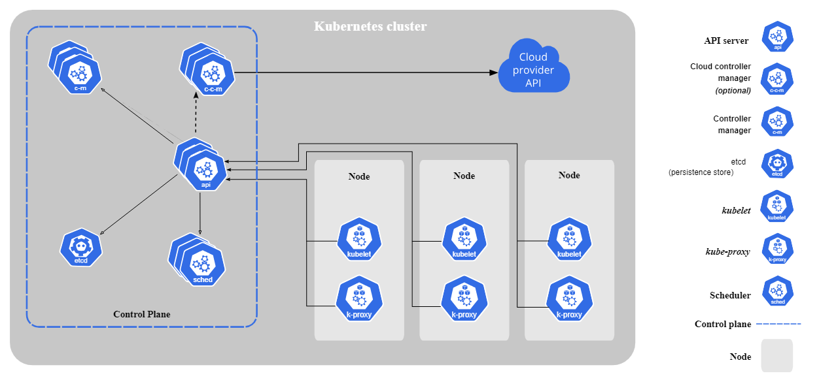
Kubernetes Architecture
etcd
Scheduler
K8s API Server
Kube-Controller Manager
Cloud-Controller Manager
Container Runtime
Container Runtime
Container Runtime
Master Node
Worker Node
Worker Node
Worker Node
Notes:
Kubernetes nodes: worker nodes (can be VM or physical machines) that maintain multiple running pods and provide Kubernetes’ runtime environment. Main components on worker nodes
etcd: A distributed key-value store that stores the cluster's configuration data and state. Scheduler: Assigns newly created pods to nodes based on available resources and constraints. API Server: Exposes the Kubernetes API and serves as the interface between the user and the cluster. Controller Manager: Ensures desired state of cluster by running controllers that manage resources like replication, scaling & health checks. kube-proxy: Manages network routing for services, enabling communication between pods across nodes. kubelet: An agent running on each node that ensures the containers in the pod are healthy and running as expected. Container runtime: A container runtime, also known as container engine, is a software component that can run containers on a host operating system. E.g. Docker and containerd.

Slide 19
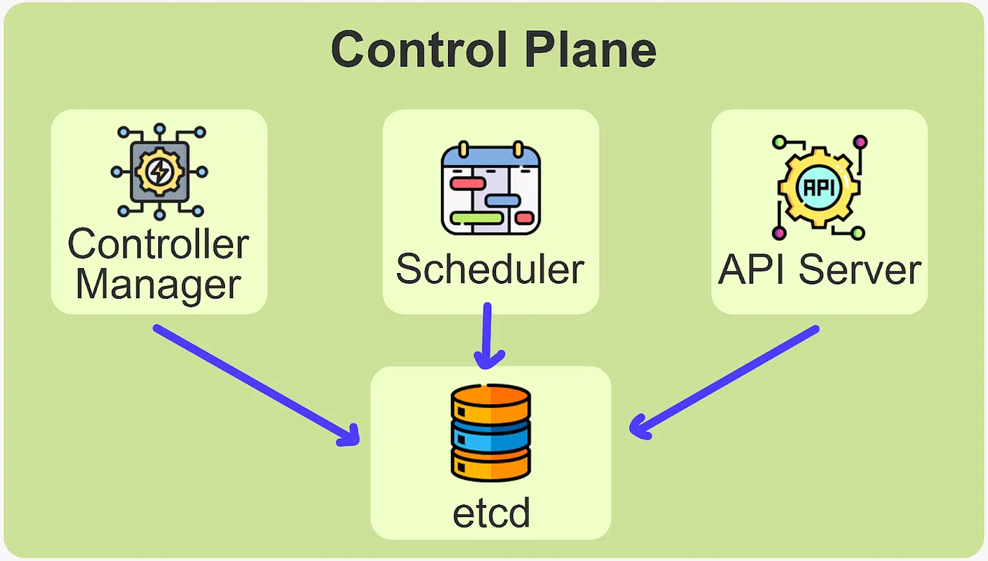
Kubernetes Architecture
etcd
Imagine etcd as a Notebook where K8s writes down everything it needs to remember about the cluster.
Distributed key-value store
Cluster configuration and state is stored in etcd
Because it’s distributed, more than one etcd can run
Distributed consensus based on a quorum model
Only API server talks directly to etcd, benefits of this:
request validation
Optimistic concurrency control
Keep consistency of the cluster state
Notes:
Etcd is the key-value store where Kubernetes keeps all of its data, including configurations, cluster states, and desired states of applications. Imagine etcd as a notebook where Kubernetes writes down everything it needs to remember about the cluster. For example, if we define that we want 3 replicas of an app in a manifest file, Kubernetes stores this desired state in etcd. RAFT (Reliable And Fault Tolerant) consensus-based algorithm.

Slide 20
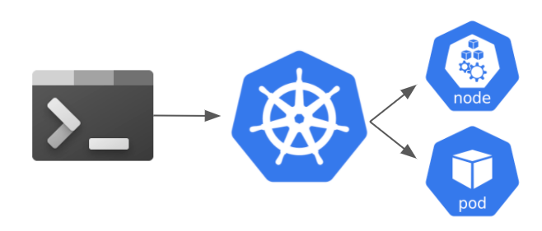
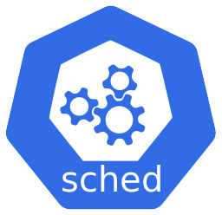
Kubernetes Architecture
Scheduler
Think of the Scheduler as the seating manager in a restaurant. If we deploy 5 pods, the Scheduler finds nodes with enough CPU and memory to run them.
Makes pod scheduling decisions based on:
resource requirements
hardware, software and policy constraints
affinity or anti-affinity specifications
data locality
Multiple Schedulers can run, for each pod a specific Scheduler can be chosen
Monitors system state for newly created pods that do not have nodes assigned
Notes:
The Kubernetes scheduler is responsible for selecting the appropriate node for a pod to run on based on resource availability, constraints, and policies. The key components of the scheduler include:
Scheduler Extenders: Custom extensions to modify or enhance the scheduling process.
Predicates: Functions that evaluate whether a node can accommodate a pod based on factors like CPU, memory, and other node-specific constraints.
Priorities: Weigh the nodes based on specific priorities, such as affinity rules or resource optimization, to determine the best fit.
Binding: After selecting the node, the scheduler binds the pod to the chosen node by updating the pod's specification in the API server.
The scheduler works by constantly watching the API server for unscheduled pods, evaluating the available nodes, and assigning the pods based on the criteria mentioned above.

Slide 21
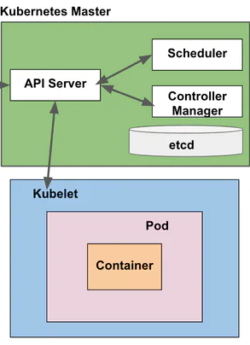
Kubernetes Architecture
Kubelet: Worker Nodes
The Kubelet is the main worker on each node. If the API Server tells the Kubelet to run 2 containers for an application, the Kubelet makes sure those containers are created and kept alive.
Kubelet is a node daemon that is present on every node and manages:
communication with an API server
container runtime
networking (via CNI)
storage volumes
image lifecycle
metric and event collection, logging
management of special devices (GPUs)
resource constraint and QoS enforcement
Worker Node
Notes:
The Kubernetes API server communicates with the kubelet by sending and receiving instructions regarding the desired state of the containers on a node, such as pod specifications, health checks, and updates, allowing the kubelet to ensure that the containers are running and managed according to the cluster's desired state.

Slide 22
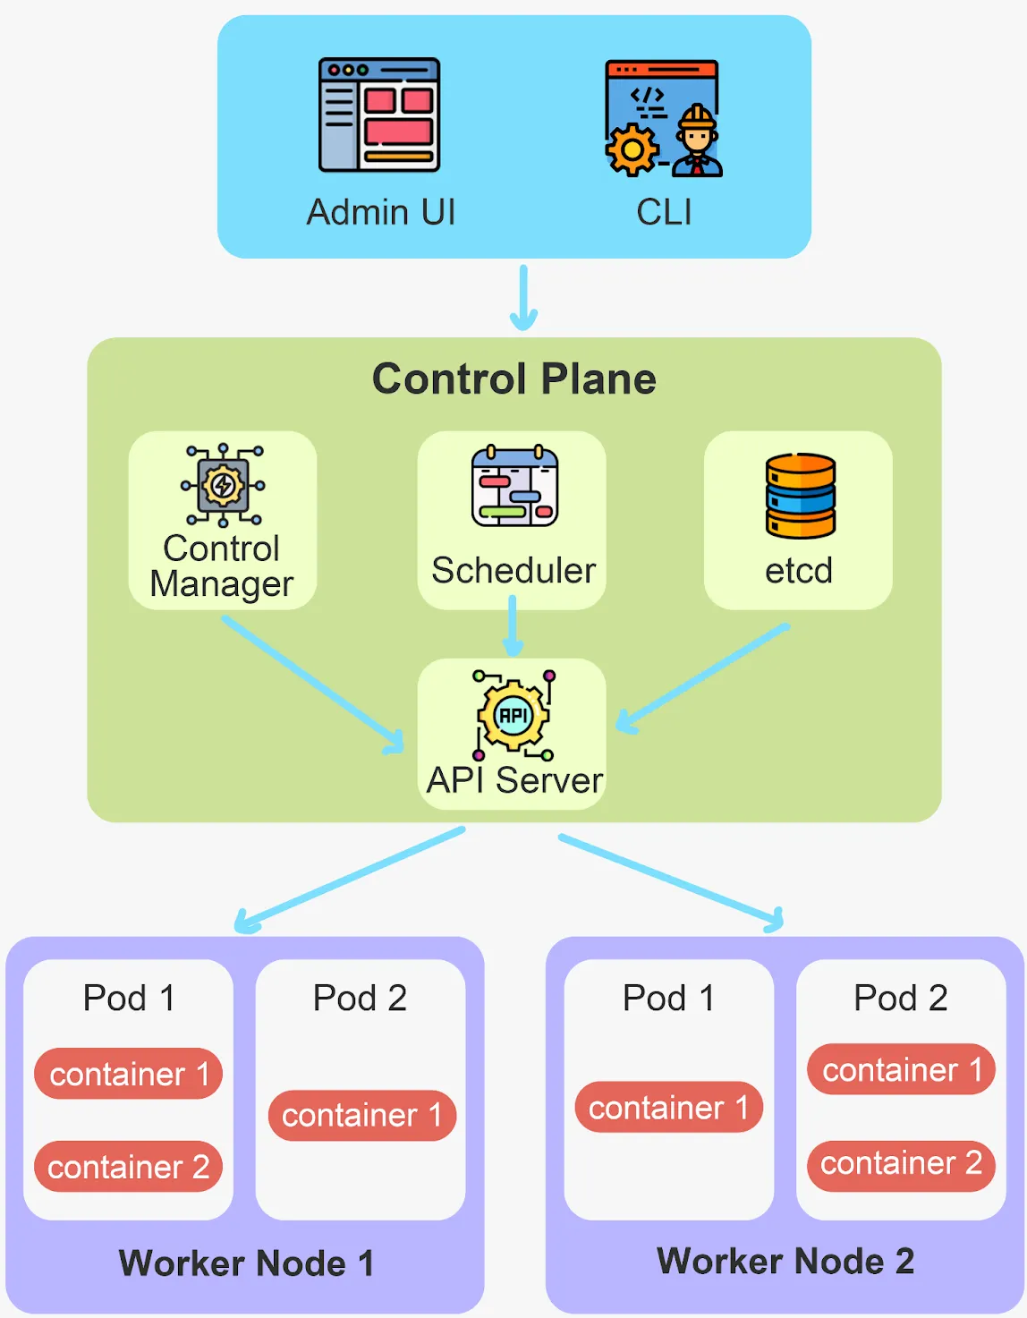
Kubernetes Architecture
API Server
API Server is a Traffic Controller that accepts requests (instructions) & directs them to the right K8s component.
Stores object data in a backend database (etcd).
Multiple API servers can handle requests at the same time (provided that load-balancing or load-sharing is done via an external mechanism).
Uses API Access Extensions in order to authenticate and authorize (via RBAC) REST API requests/users.
Dynamic Admission Control is also supported.
When we use a command like kubectl apply to deploy an application, the API Server processes the request and ensures the cluster takes action.
Notes:
The Kubernetes API server serves as the central management interface that exposes the API, handles requests from users or clients, and interacts with other components to maintain the desired state of the cluster.

Slide 23
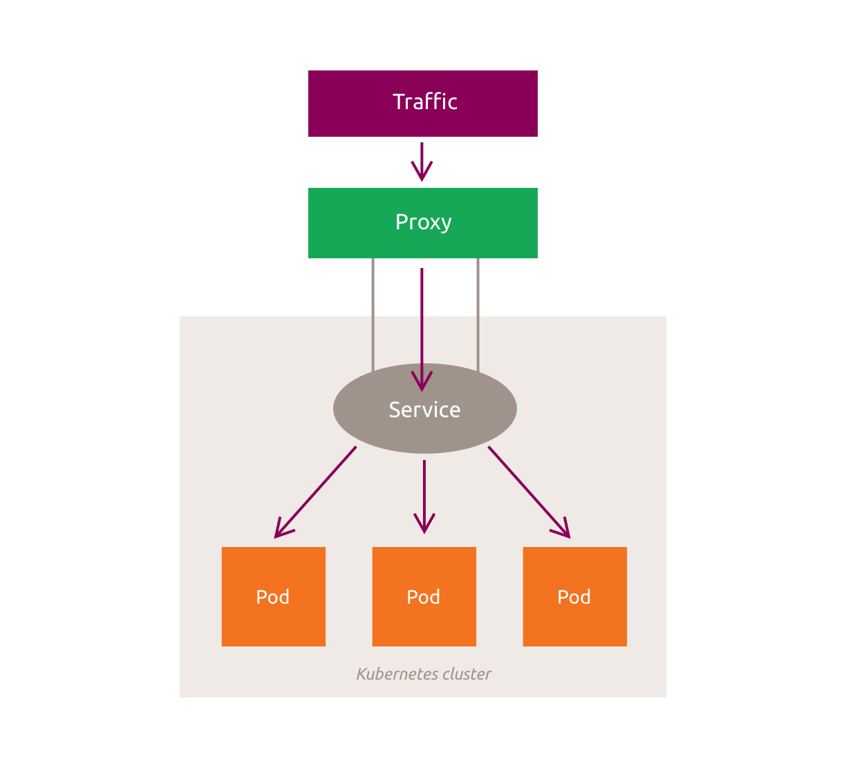
Kubernetes Architecture
Kube-proxy: Worker Nodes
Kube-proxy handles networking on each node. It ensures that services can communicate with pods and traffic is properly routed across the cluster. If an external request for a web app is received, Kube-proxy routes it to one of the pods running that particular application.
Kube-proxy runs on each node and provides:
load-balancing for cluster IPs (Virtual IPs)
ensures clients can connect to the defined services through the API
Notes:
kube-proxy in Kubernetes is responsible for maintaining network rules on each node, enabling communication between pods and services. It manages the routing of network traffic to the correct pod by handling load balancing and ensuring that traffic is directed to the appropriate endpoint, whether the pod is on the same node or a different one. Underneath, kube-proxy uses iptables (a Linux utility) or IPVS (IP Virtual Server) for efficient load balancing and service discovery. iptables is the default technology, allowing kube-proxy to create and manage network rules that rewrite packet destinations and direct traffic to the correct pod. For improved performance in larger clusters, kube-proxy can also switch to IPVS, which provides better scalability and faster processing. Additionally, kube-proxy can use a SOCKS5 proxy in userspace mode for forwarding traffic to pods. These technologies enable kube-proxy to effectively manage network connectivity and routing within a Kubernetes cluster.

Slide 24
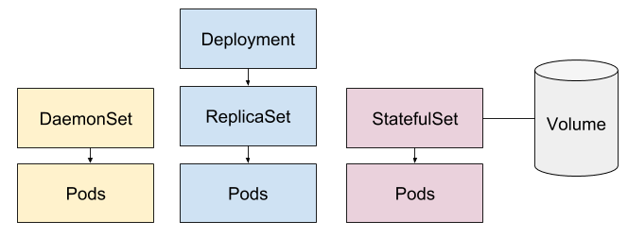
Kubernetes Architecture
Controller Manager
Runs different controllers:
ReplicaSet, DaemonSet, StatefulSet, Namespace, Persistent Volume.
Manages worker threads and participates in leader elections with other controller managers in an HA scenario.
If a node crashes and some pods go offline, the Controller Manager identifies the issue and spins up new pods on healthy nodes to match the desired state.
The Controller Manager ensures that the cluster’s desired state matches the actual state.
Notes:
The Controller Manager in Kubernetes is responsible for ensuring that the desired state of the cluster is maintained. It runs various controllers that watch the state of the cluster and take actions to reconcile the current state with the desired state. For example, the ReplicationController ensures that the correct number of replicas of a pod are running, while the DeploymentController manages the rollout of new versions of an application. The Controller Manager handles tasks like scaling pods, maintaining services, and ensuring high availability.
Deployment: Manages the deployment and scaling of a set of identical pods, ensuring desired state and handling updates and rollbacks. ReplicaSet: Ensures a specified number of identical pod replicas are running, often used by Deployments to maintain availability. DaemonSet: Ensures that a copy of a pod runs on all or selected nodes in the cluster, typically for background or system services. StatefulSet: Manages stateful applications by providing stable, unique identities, persistent storage, and ordered pod deployment. Namespace: Provides logical separation within a cluster, enabling multiple environments or teams to coexist independently. Persistent Volume (PV): An abstraction for storage that provides persistent storage independent of pod lifecycle, managed by the Kubernetes administrator.

Slide 25
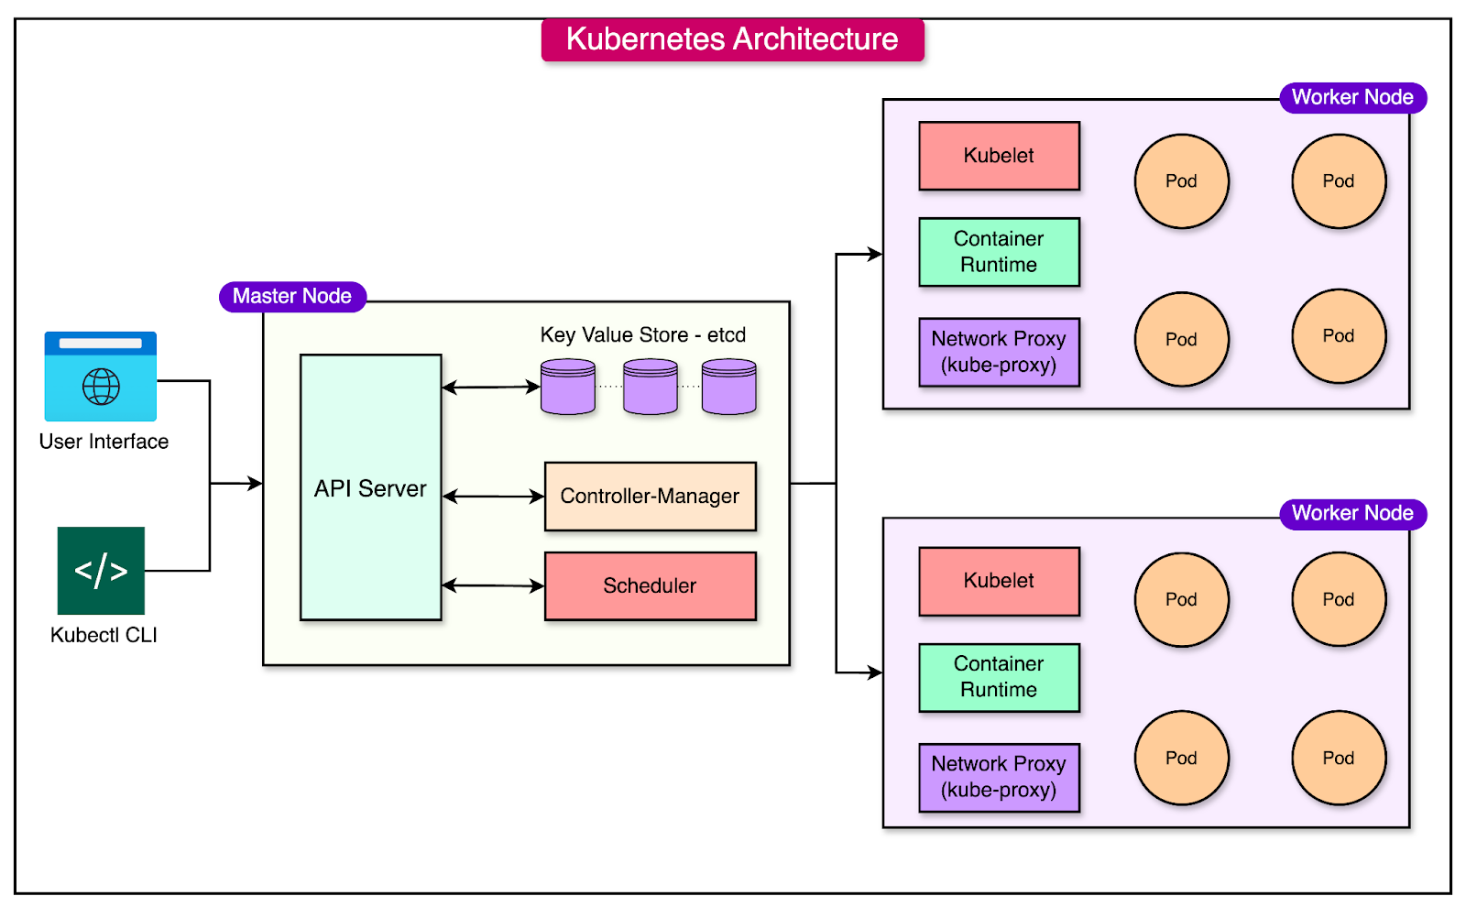
Kubernetes Architecture
https://blog.bytebytego.com/p/kubernetes-made-easy-a-beginners

Slide 26
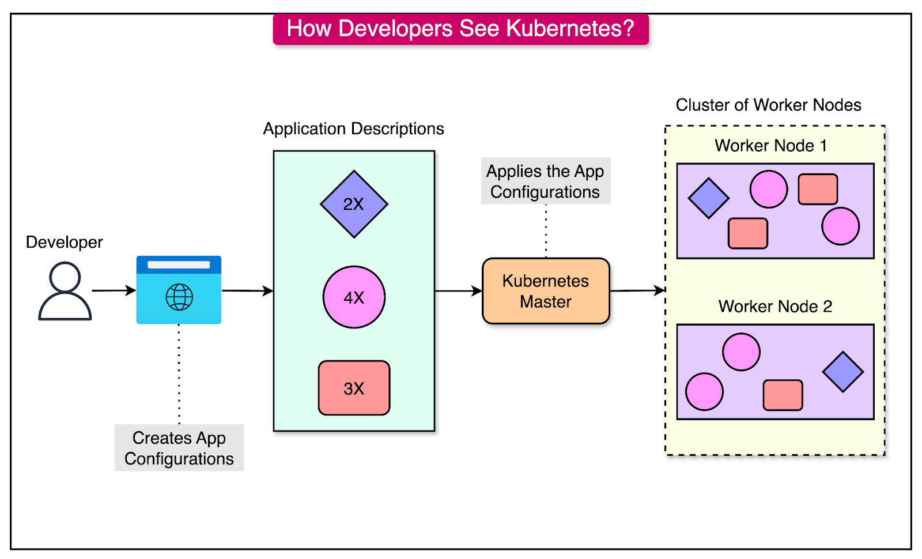
Kubernetes Architecture
https://blog.bytebytego.com/p/kubernetes-made-easy-a-beginners
Notes:
For application developers working with Kubernetes, the process can be broken down into three simple steps:
Step 1: Developers create manifest files (typically written in YAML or JSON) that describe their applications, specifying the number of instances, resource requirements, and configurations. These manifest files are then submitted to Kubernetes.
Step 2: Kubernetes takes these manifest files, validates them, and deploys the applications across its cluster of worker nodes, ensuring that resources are allocated appropriately.
Step 3: Kubernetes continuously manages the entire lifecycle of the applications based on the instructions provided in the manifest files. This includes tasks like scaling, restarting failed containers, and ensuring the desired state of the application is maintained.

Slide 27
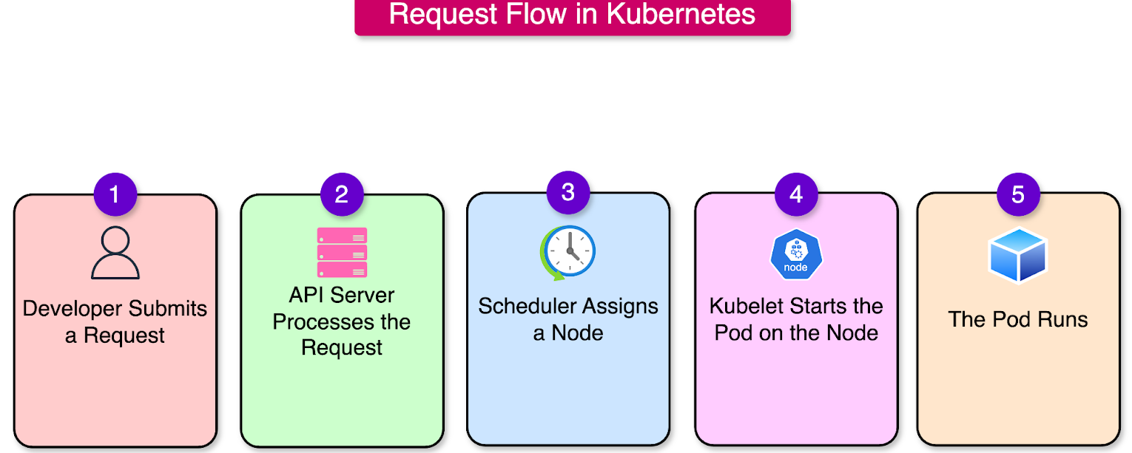
Kubernetes Architecture
https://blog.bytebytego.com/p/kubernetes-made-easy-a-beginners
Notes:
Here’s what happens in each step:
Step 1 - The Developer Submits a Request
A developer creates a manifest file (YAML or JSON) describing the desired state, such as deploying a pod or scaling an application. Then, the developer runs a command, like:
kubectl apply -f my-app.yamlThe kubectl command-line tool sends this request to the API Server.
Step 2 - API Server Processes the Request
The API Server (kube-apiserver) receives the request and validates the manifest file for correctness (syntax, resource names, etc.).
After validation, the API Server stores the request in etcd, the cluster's key-value store. This is to ensure the current state of the cluster (what’s running) and the desired state (what the developer wants) are tracked persistently.
Step 3 - Scheduler Assigns a Node
Once the request is stored in etcd, the Scheduler steps in. It checks the cluster’s available nodes and resources to determine the best place to run the pod.
The Scheduler also considers factors like CPU, memory availability, and affinity rules to make its decision. After assigning the pod to a specific node, the Scheduler updates the API Server with this information.
Step 4 - Kubelet Starts the Pod on the Node
The API Server informs the Kubelet (the main worker agent) on the chosen node about the new pod to be created.
The Kubelet pulls the container image from a container registry such as Docker Hub and starts the container on the node using the container runtime (for example, Docker). It then monitors the pod to ensure it is running as expected.
Step 5 - The Pod Runs and Reports Back
Once the container is up and running, the Kubelet communicates with the API Server, confirming that the pod has been successfully started.
The API Server updates etcd with the current state of the cluster to reflect this change. If something goes wrong (such as the container crashing), the Controller Manager detects this issue and restarts the pod to ensure the desired state is restored.

Slide 28
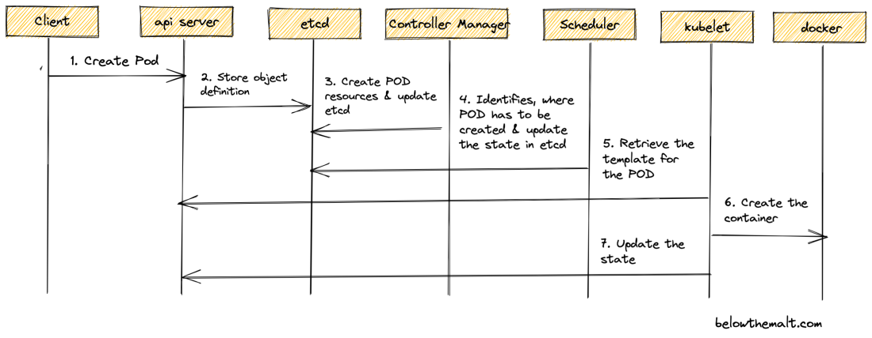
Kubernetes Architecture
POD Creation Process
Container Runtime
Notes:
An example of how the API server works with the kubelet:
1. User or Controller: A user or a controller submits a request to the Kubernetes API server to create a new pod with a specific container image.
2. API Server: The API server processes this request and stores the desired pod state in etcd (Kubernetes’ distributed key-value store). The API server then informs the kube-scheduler to assign the pod to an appropriate node.
4. Scheduler: The scheduler selects an available node for the pod and communicates the pod’s specification to the API server.
5. API Server to Kubelet: The API server updates the kubelet on the selected node with the pod's configuration.
6. Kubelet: The kubelet receives the pod specification, pulls the container image if necessary, and starts the container. It also continuously monitors the container's health and reports the current status back to the API server.
7. API Server: The API server updates the pod’s status in etcd and reflects the current state of the pod (e.g., running, failed) for other components to act upon.
Explaining Steps 5 & 6) The kubelet retrieves the pod specification (template) from the Kubernetes API server. When a pod is scheduled to run on a node, the kubelet is responsible for ensuring that the containers defined in the pod specification are started. The kubelet:
Fetches the Pod Specification: The kubelet continuously watches the Kubernetes API server for any changes in the pod's state. When a pod is assigned to a node, the kubelet pulls the pod's specification (usually in YAML or JSON format) from the API server.
Delegates to Container Runtime: Based on the pod specification, the kubelet then delegates the task of creating and running the containers to the container runtime, such as Docker (or other container runtimes like containerd or CRI-O). The kubelet provides the pod specification, including details about the container image, resources, ports, etc., to the container runtime.
Container Creation: The container runtime (e.g., Docker) uses the provided specification to pull the container image (if not already available) and start the container according to the pod’s configuration.

Slide 29
Kubernetes in 100 seconds!
https://www.youtube.com/watch?v=PziYflu8cB8

Slide 30
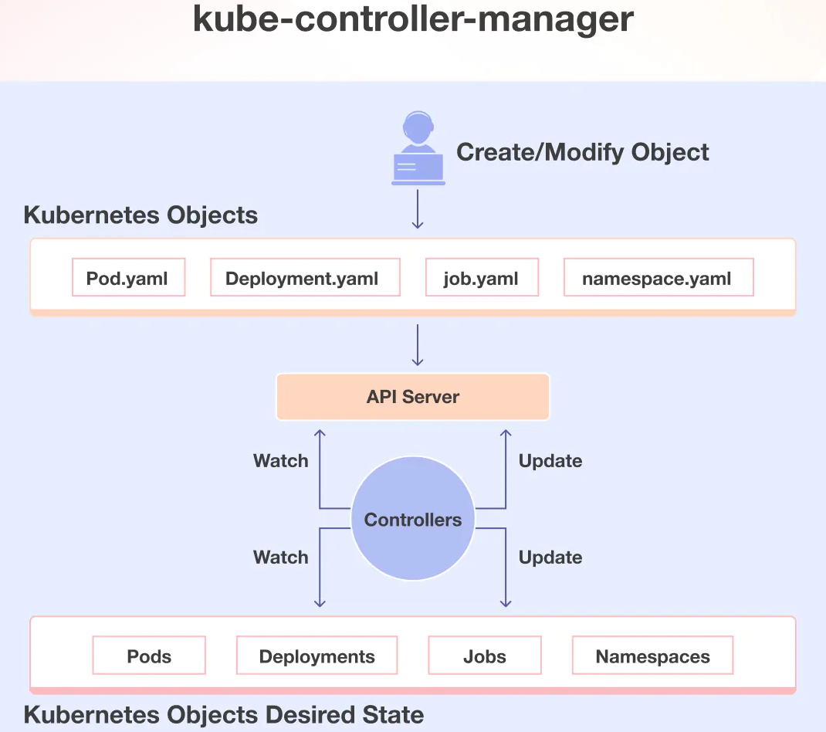
Kubernetes Data Model
Kubernetes data model is governed by versioned API object specifications.
The Kubernetes Data Model organizes & manages resources in a cluster, ensuring the system's desired state is met. It's based on declarative configuration, where users define the desired state, and Kubernetes works to reconcile the actual state. We use YAML to manage resources in Kubernetes.
Resource Objects: Represents Kubernetes entities like Pods, Services, Deployments, Namespace.
Desired State: The configuration users define (e.g., number of replicas, container images).
Controllers: Components that monitor the actual state and ensure it matches the desired state.

Slide 31
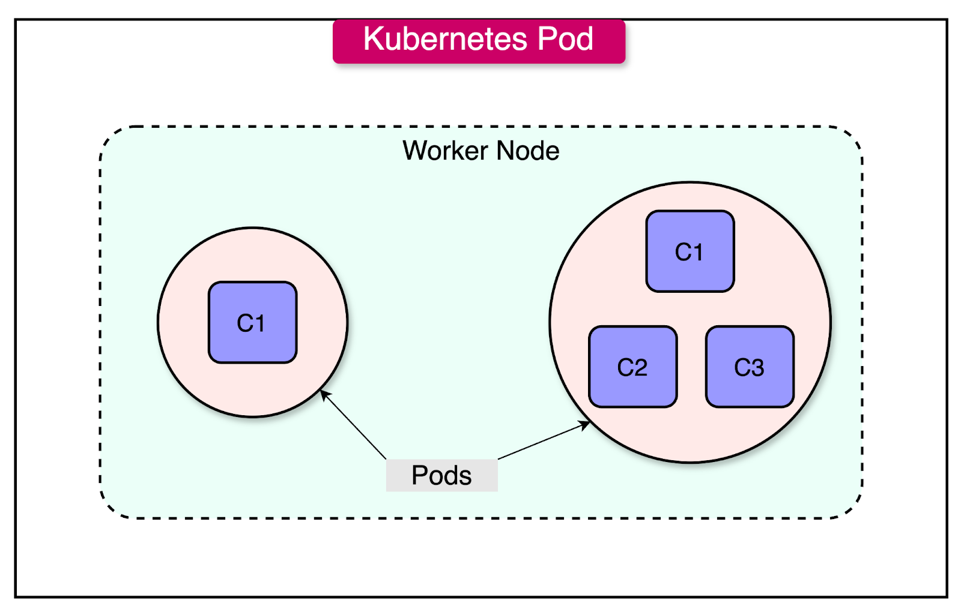
Kubernetes Data Model: Pod
A Pod can host a single container, which is the most common use case. Alternatively, a Pod can run multiple containers that are coupled in some way. For example, a primary app container and a sidecar (helper) container for logging.
The containers in a Pod share the same IP address and port space. They can also share volumes for persistent storage.
Pods are designed to be short-lived (ephemeral). If a Pod fails, Kubernetes will restart it (or replace it) to match the desired state.
https://blog.bytebytego.com/p/kubernetes-made-easy-a-beginners
Notes:
Pods encapsulate one or more containers, storage resources, and configuration options needed for the containerized application to run. Containers in a Pod run together on the same node and Kubernetes uses Pods as the deployable unit rather than individual containers. In simple terms, a Pod is a wrapper for containers. It provides an environment where containers can share storage, network, and lifecycle management.

Slide 32
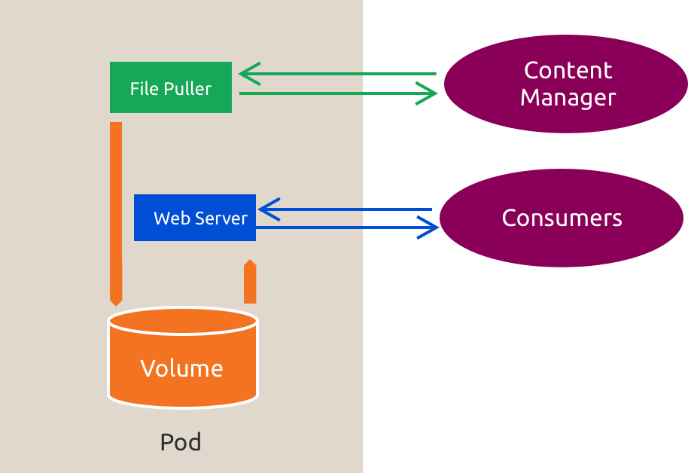
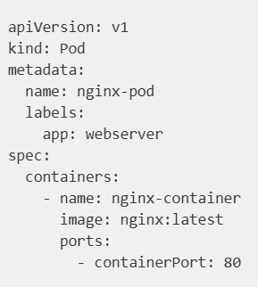
Kubernetes Data Model: Pod creation
nginx-pod.yaml
$ kubectl apply -f nginx-pod.yaml
Notes:
The image represents a Kubernetes pod with two main components:
File Puller: This component pulls the container image (likely for an nginx web server) from an external source or container registry into the pod.
Web Server: The nginx web server uses the pulled image to serve content to consumers.
The pod also includes a Volume to store the data, and the Content Manager is responsible for organizing or managing the content before it’s served by the web server. This setup ensures that the web server always has the correct container image and content to serve to external consumers.
Here’s what the various parts of the YAML file mean:
apiVersion: Defines the Kubernetes API version to use. v1 is the stable API version for Pods.
kind: Specifies the type of Kubernetes object. Here, it is a Pod.
metadata:
name: A unique name for the Pod within the namespace.
labels: Key-value pairs used to organize and identify the Pod.
Spec: Describes the desired behavior of the Pod.
containers: A list of containers in the Pod.
name: A name for the container inside the Pod.
image: The container image to pull from a container registry such as Docker Hub
ports: The port(s) exposed by the container.
The containerPort does not automatically expose the pod to external traffic. It is primarily for documentation purposes and provides clarity to users and tools about which ports the container will listen on internally. Indeed, without a service, other pods within the cluster could communicate directly with the nginx pod on port 80, provided they know the pod's IP address. on the other hand, a service would forward traffic from its defined port to the containerPort. For instance, a Service could map port 8080 on the cluster to port 80 in the container.

Slide 33
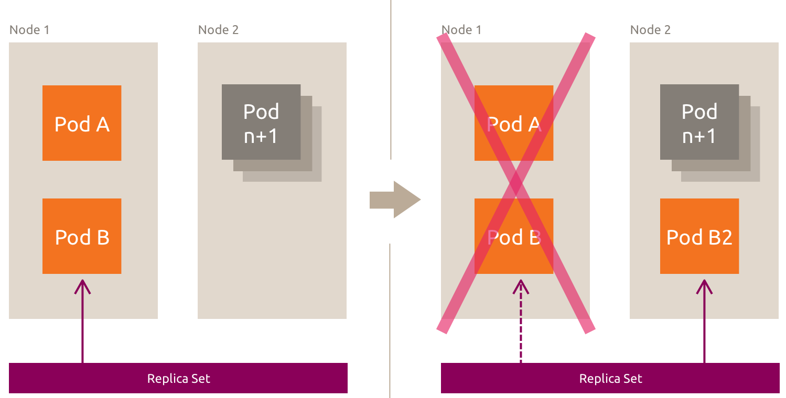
Kubernetes Data Model: ReplicaSet
ReplicaSet: A Self-healing group of similar pods
Pods are ephemeral copies of each other.
Make sure desired number of pods running.
Automatically replaces any pod that failed or deleted.
guarantees
High Availability and Fault Tolerance
for the application.
ReplicaSet are typically used alongside
Deployments
to manage pod scaling and rolling updates.
Pod A is not part of the ReplicaSet, but Pod B is and as soon as Node 1 is down, Pod B will be rescheduled to another node.

Slide 34
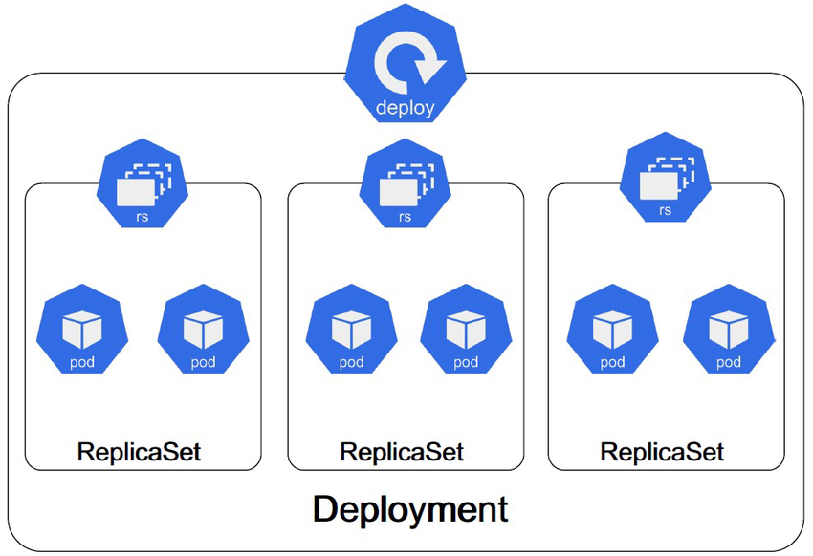
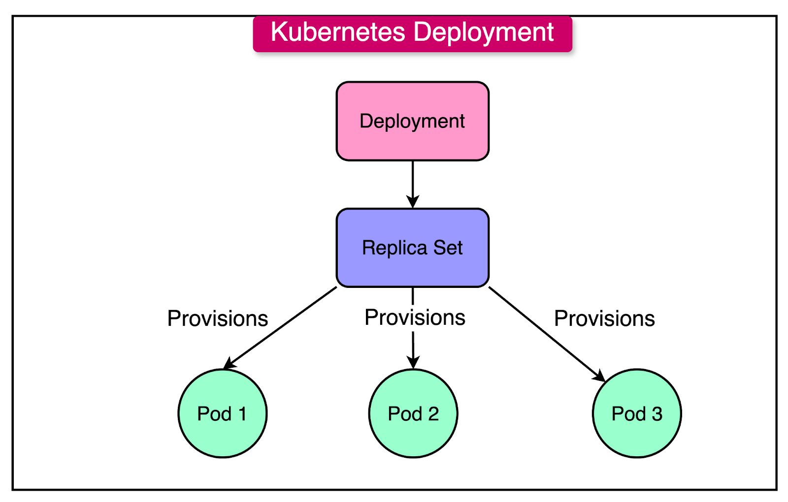
Kubernetes Data Model: Deployment
ReplicaSet ensures that a specified number of pod replicas are running at any given time.
Deployment is a higher-level abstraction that manages Pods and ensures they run reliably.
Deployment
Deployment creates a ReplicaSet in the background
ReplicaSet creates Pods in the background.

Slide 35
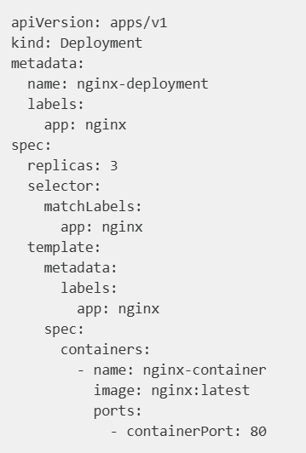
Kubernetes Data Model: Deployment
Deployment ensures a container for pods deployed, managed, and removed together.
Deployment creates a ReplicaSet in the background
ReplicaSet creates Pods in the background.
Declarative Updates
Rolling Updates
Automatic Rollback
Scaling
Self-healing
Version Control
Ease of Management
Key Advantages of using
Deployment
To scale the Deployment from 3 to 5 replicas, we can run:
$ kubectl scale deployment nginx-deployment --replicas=5
$ kubectl apply -f deployment.yaml
Notes:
A Deployment automatically creates and manages a ReplicaSet to ensure the desired number of replicas. The Deployment takes care of the upgrade process, while the ReplicaSet focuses on maintaining the correct number of pods. In summary, Deployment is a higher-level controller that uses ReplicaSet to maintain and manage pod replicas and offers additional management features like updates and rollbacks.
Deployments provide versioning of your application, making it easier to manage and track changes over time. If a deployment fails or doesn’t meet the desired state, Kubernetes can automatically roll back to a previous working version. You can perform rolling updates to your application without downtime, ensuring a smooth transition between versions.
spec: Describes the desired behavior of the Deployment.
replicas: Specifies the desired number of Pod replicas.
selector: Determines which Pods the Deployment manages using labels.
template: Defines the Pod specification.

Slide 36
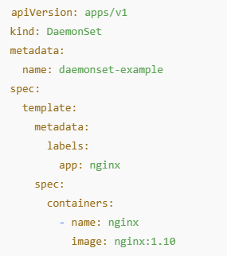
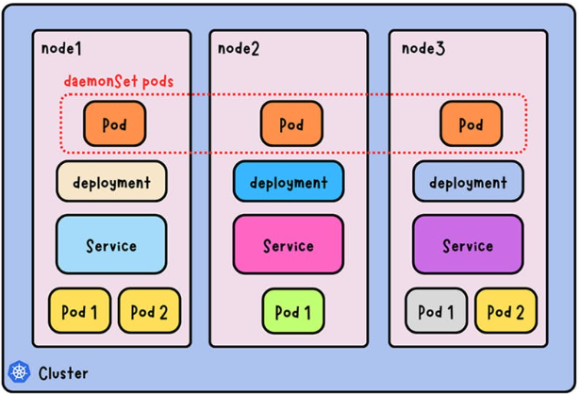
Kubernetes Data Model: DaemonSet
A DaemonSet ensures that all (or some) Nodes run a copy of a Pod. New nodes added to the cluster get pods added to them automatically. As nodes are removed from the cluster, those Pods are automatically deleted. Why we need it?
Running a cluster storage daemon, such as ceph, on each node.
Running a logs collection daemon on every node, such as logstash.
Running a node monitoring daemon on every node, such as Zabbix.
Running ingress controller worker pods (a load balancer to handle L7 traffic)
Notes:
DaemonSet: Ensures a pod runs on every node (or a subset of nodes), used for system-level tasks.Deployment: Ensures a specified number of replicas of a pod are running, used for stateless applications with flexible pod placement.
DaemonSet used to deploy a logging agent or monitoring tool to every node in the cluster (e.g., deploying Fluentd or Prometheus node exporters to collect logs or metrics from every node). Deployment used for running stateless applications like web servers or microservices, where the pods can run on any node in the cluster and are not tied to specific nodes.

Slide 37
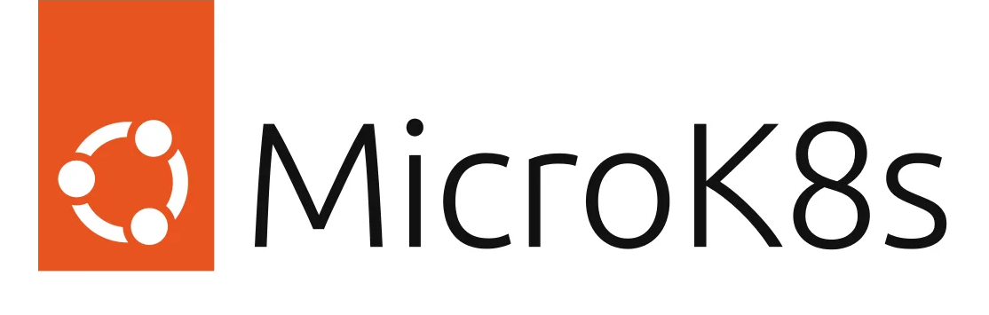
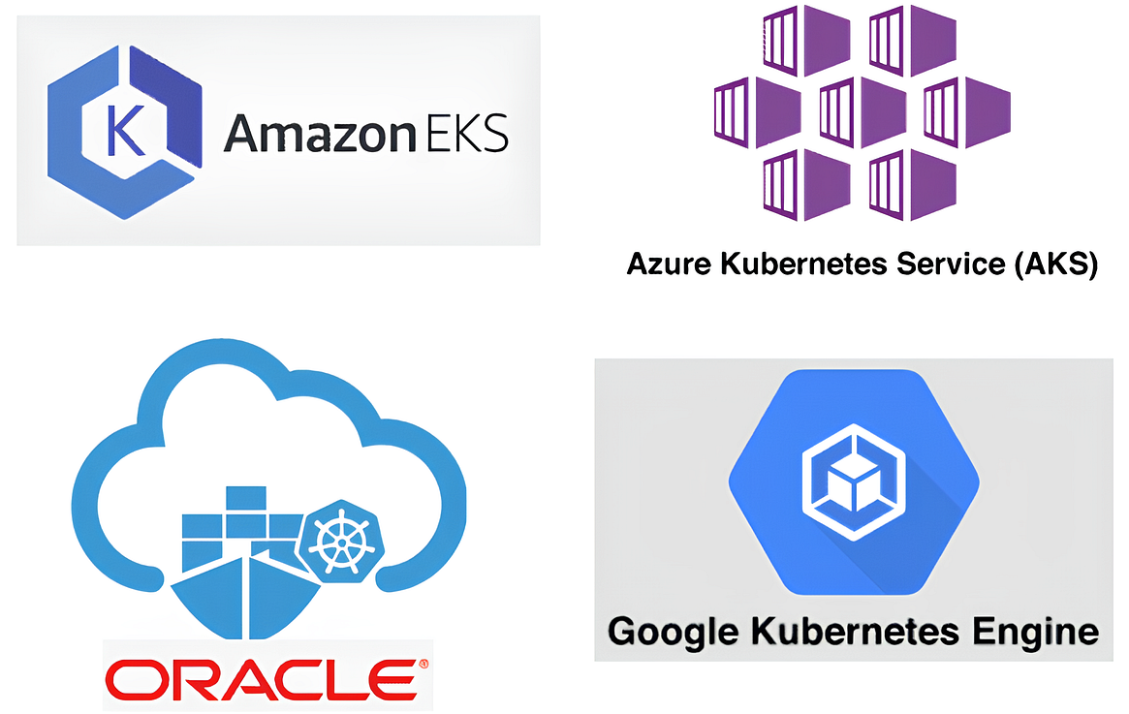
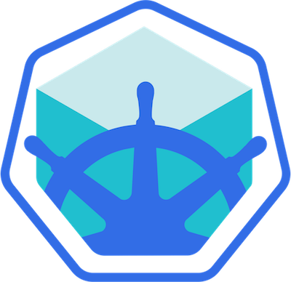
Kubernetes from different vendors
Minikube: A tool that enables running Kubernetes locally.
Lightweight Kubernetes implementation for development and testing.
Supports multiple drivers (Docker, Hyper-V, etc.).
https://microk8s.io/
Easy to install and use.
Runs Kubernetes in a single-node cluster.
Suitable for local development and testing.
Compatible with most Kubernetes tools and workflows.
https://kubernetes.io/releases/download/
https://minikube.sigs.k8s.io/docs/
Vanilla K8s
MiniKube
Notes:
"Vanilla" Kubernetes, referring to the basic, open-source version of the platform, is primarily managed and maintained by the Cloud Native Computing Foundation (CNCF), which is part of the Linux Foundation;

Slide 38
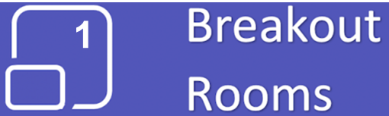
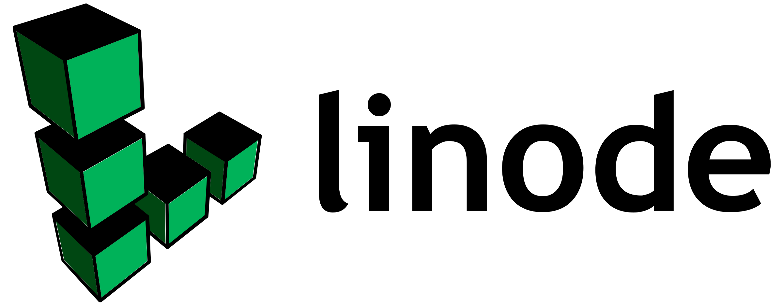
Building your K8s Cluster in Linode
Notes:
"Vanilla" Kubernetes, referring to the basic, open-source version of the platform, is primarily managed and maintained by the Cloud Native Computing Foundation (CNCF), which is part of the Linux Foundation;

Slide 39
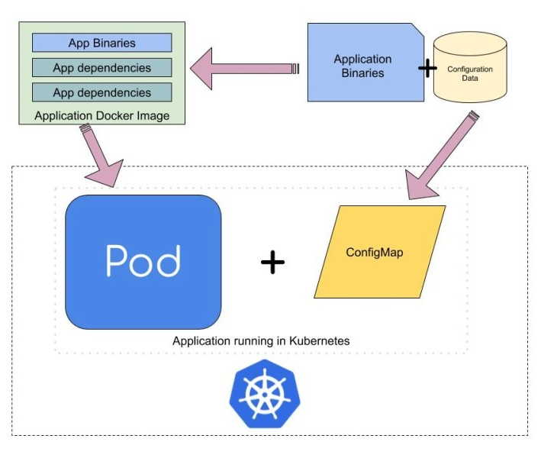
Kubernetes Data Model: ConfigMaps
The flow highlights the separation of application code from configuration data, making the system more flexible and easier to manage in a K8s environment.
The application uses ConfigMap to access configuration data separately from the application binaries. This allows configuration updates without modifying the Docker image or redeploying the app.
Notes:
This image illustrates how Kubernetes manages application configuration and deployment using ConfigMaps. The flow highlights the separation of application code from configuration data, making the system more flexible and easier to manage in a Kubernetes environment.

Slide 40
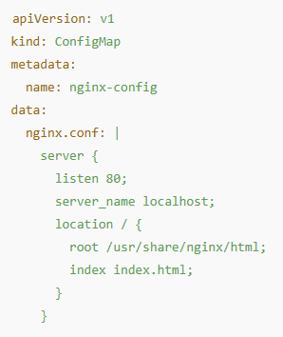
Kubernetes Data Model: ConfigMaps
Decouple Configuration from Code:
ConfigMaps allow you to separate configuration from application code. This makes your applications more flexible and portable because you can update configuration values without changing the application code.
Environment-specific Settings:
ConfigMaps can store environment-specific configurations, making it easier to deploy the same application in multiple environments (e.g., development, staging, production) with different settings.
ConfigMap is a K8s object that allows you to store non-confidential data in key-value pairs. In this example, a ConfigMap named nginx-config stores the contents of an nginx.conf configuration file.
Notes:
In K8s, Secrets are used to store confidential data (such as passwords, API keys, and tokens) securely, instead of using ConfigMaps. Secrets are specifically designed for sensitive information and provide encryption at rest, better access controls, and a more secure approach to managing confidential data.

Slide 41


Kubernetes Data Model: Secrets
A Secret is similar to a ConfigMap but is designed to store sensitive (confidential) data such as passwords, tokens, SSH keys, and API credentials. The data in Secrets is base64-encoded to add a basic level of obfuscation.
Create a ConfigMap
Create a Secret
Notes:
In K8s, Secrets are used to store confidential data (such as passwords, API keys, and tokens) securely, instead of using ConfigMaps. Secrets are specifically designed for sensitive information and provide encryption at rest, better access controls, and a more secure approach to managing confidential data.

Slide 42

Kubernetes Data Model: ConfigMaps/Secrets example
This YAML defines a Pod named app-pod running a single container named app-container based on the nginx:latest image. The container is configured to use environment variables sourced dynamically from a ConfigMap and a Secret. The APP_NAME and APP_ENV environment variables retrieve their values from the app-config ConfigMap, while the DB_PASSWORD environment variable retrieves its value from the app-secret Secret. This allows sensitive data like passwords and configuration values to be managed externally, enhancing security and flexibility.
By referencing to ConfigMaps and Secrets, the configuration decouples the application settings and credentials from the application code, enabling easy updates and secure management.
Notes:
In K8s, Secrets are used to store confidential data (such as passwords, API keys, and tokens) securely, instead of using ConfigMaps. Secrets are specifically designed for sensitive information and provide encryption at rest, better access controls, and a more secure approach to managing confidential data.

Slide 43


Kubernetes Data Model: StatefulSets
Deployment: Best suited for stateless applications where individual pods do not need to maintain any state between restarts (e.g., Web servers, DNS servers, Micro-services).
StatefulSet: Ideal for Stateful Applications such as databases (e.g., MySQL, PostgreSQL), where each instance (Pod) needs to have a stable identity and persistent data storage across restarts.
Pods are ephemeral in nature, when it is deleted it will lose all the state and associated data if it is stored locally. To keep the data, we need to create Persistent Volume Claim.
Notes:
StatefulSets provide persistent storage by automatically provisioning and associating Persistent Volumes (PVs) with each pod. Each pod gets its own Persistent Volume Claim (PVC) that is maintained across restarts, ensuring that the storage is stable and tied to the specific pod.

Slide 44



Kubernetes Data Model: StatefulSets
YAML file to define a PV
YAML file to define a PVC
https://blog.bytebytego.com/p/kubernetes-made-easy-a-beginners
Notes:
In PV we specify the capacity, access modes, and the host path (storage on the worker node’s local filesystem). The PVC specifies the amount of storage requests and access mode. When this PVC is applied, Kubernetes will bind it to the mysql-pv Persistent Volume.

Slide 45

Kubernetes Data Model: StatefulSets
This configuration mounts the PV at /var/lib/mysql, which is the default directory for MySQL data. It uses mysql-pvc to attach the storage to the pod.
https://blog.bytebytego.com/p/kubernetes-made-easy-a-beginners
Notes:
In PV we specify the capacity, access modes, and the host path (storage on the worker node’s local filesystem). The PVC specifies the amount of storage requests and access mode. When this PVC is applied, Kubernetes will bind it to the mysql-pv Persistent Volume.

Slide 46

Kubernetes Data Model: StatefulSets

Slide 47
Pod
Container Runtime
Deployment
Service
ReplicaSet
ConfigMap
API Server
Kubernetes
Networking
Secret
HPA
Scheduler
CNI
CNI
etcd
Service
DaemonSet
StatefulSet
Scaling
HPA
Kube-proxy
Kubelet
Controller Manager
Scaling

Slide 48

K8s Cluster Networking
If Kubernetes Cluster Networking is configured properly, then
1. All containers/PODs can communicate to one another without NAT.
2. All nodes can communicate with all containers and vice-versa without NAT.
Notes:
So it’s all easy and simple to understand when it comes to networking on a single node. But how does it work when you have multiple nodes in a cluster? In this case we have two nodes running kubernetes and they have IP addresses 192.168.1.2 and 192.168.1.3 assigned to them. Note that they are not part of the same cluster yet. Each of them has a single POD deployed. As discussed in the previous slide these pods are attached to an internal network and they have their own IP addresses assigned. HOWEVER, if you look at the network addresses, you can see that they are the same. The two networks have an address 10.244.0.0 and the PODs deployed have the same address too. This is NOT going to work well when the nodes are part of the same cluster. The PODs have the same IP addresses assigned to them and that will lead to IP conflicts in the network. Now that’s ONE problem. When a kubernetes cluster is SETUP, kubernetes does NOT automatically setup any kind of networking to handle these issues. As a matter of fact, kubernetes expects US to setup networking to meet certain fundamental requirements. Some of these are that all the containers or PODs in a kubernetes cluster MUST be able to communicate with one another without having to configure NAT. All nodes must be able to communicate with containers and all containers must be able to communicate with the nodes in the cluster. Kubernetes expects US to setup a networking solution that meets these criteria.

Slide 49



K8s Cluster Networking: CNI
Container Network Interface (CNI) a standard network implementation interface that allows Kubelet to call different Network Plugins to implement network configuration methods.
CNI is not a specific networking solution, it is a framework that enables the use of various networking plugins. Indeed, it defines how to connect containers to networks and manage their IP addresses.
Networking Plugins such as Calico/Cilium/flannel use CNI to provide advanced features like networking, network policies & security for K8s clusters.
Notes:
Fortunately, we don’t have to set it up ALL cluster networking on our own as there are multiple pre-built solutions available. Some of them are the cisco ACI networks, Cilium, Big Cloud Fabric, Flannel, Vmware NSX-t and Calico. Depending on the platform you are deploying your Kubernetes cluster on you may use any of these solutions. For example, if you were setting up a kubernetes cluster from scratch on your own systems, you may use any of these solutions like Calico, Flannel etc. If you were deploying on a Vmware environment NSX-T may be a good option. If you look at the play-with-k8s labs they use WeaveNet. In our demos in the course we used Calico. Depending on your environment and after evaluating the Pros and Cons of each of these, you may chose the right networking solution.

Slide 50

K8s Cluster Networking: CNI
Notes:
So back to our cluster, with the Calico networking setup, it now manages the networks and IPs in my nodes and assigns a different network address for each network in the nodes. This creates a virtual network of all PODs and nodes were they are all assigned a unique IP Address. And by using simple routing techniques the cluster networking enables communication between the different PODs or Nodes to meet the networking requirements of kubernetes. Thus all PODs can now communicate to each other using the assigned IP addresses.

Slide 51


K8s Cluster Networking: CNI
CNI Plugin Architecture
Kubelet Architecture
https://devopscube.com/kubernetes-architecture-explained/
Notes:
CNI Plugin: Container Networking Interface (CNI) is a way to create network connections for containers, and it works with many different orchestration tools, not just Kubernetes. CNI plugin configured in the cluster to allocate the pod IP address and set up any necessary network routes and firewall rules for the pod. Organizations have varying needs regarding container networking, like security and isolation. Many different companies have created solutions for these needs using CNI. These solutions are called CNI Plugins, and you can choose one based on your needs. This is how things operate when using CNI Plugins with Kubernetes: Each pod (a container or group of containers) gets a unique IP address. Then, the CNI Plugin connects the pods together, no matter where they’re located. This means that pods can communicate with each other even if they’re on different nodes. Many different CNI Plugins exist, including popular ones like Calico, Flannel, and Weave Net. It’s essential to choose the right one for your specific needs. Container networking is a huge responsibility, but CNI Plugins make managing it easier.

Slide 52

Kubernetes Data Model: Service
Service is an abstraction that provides a stable way to expose & access a set of Pods.
Since Pods are ephemeral (they can be terminated or restarted), their IP addresses keep changing (not static).
Services solve this problem by providing a Static Endpoint (IP/DNS name) to connect to a group of Pods.
Notes:
The containerPort does not automatically expose the pod to external traffic. It is primarily for documentation purposes and provides clarity to users and tools about which ports the container will listen on internally. Indeed, without a service, other pods within the cluster could communicate directly with the nginx pod on port 80, provided they know the pod's IP address. on the other hand, a service would forward traffic from its defined port to the containerPort. For instance, a Service could map port 8080 on the cluster to port 80 in the container.

Slide 53

Kubernetes Data Model: Service
Service uses labels & selectors to determine which Pods they should route traffic to.
Most commonly used types of Services
ClusterIP, NodePort, LoadBalancer
Exposes the service internally within the cluster and creates a virtual IP address only accessible from within the cluster. This is suitable for internal communication between Pods.
It is useful for testing or exposing applications externally without a cloud load balancer. Indeed it exposes the service on a static port (range: 30000–32767) on every node in the cluster. This allows external traffic to access the service using the NodeIP and NodePort.
Exposes the service externally using a cloud provider's load balancer (for example, AWS ELB, Azure Load Balancer, or GCP Load Balancer). The service automatically provisions an external IP address and is ideal for production workloads that require external access to the application.
Notes:
The containerPort does not automatically expose the pod to external traffic. It is primarily for documentation purposes and provides clarity to users and tools about which ports the container will listen on internally. Indeed, without a service, other pods within the cluster could communicate directly with the nginx pod on port 80, provided they know the pod's IP address. on the other hand, a service would forward traffic from its defined port to the containerPort. For instance, a Service could map port 8080 on the cluster to port 80 in the container. The key difference between NodePort and LB is a NodePort service is accessible via each node’s IP and a high-numbered port, so you must connect to a specific node (and port) yourself.A LoadBalancer service, on the other hand, automatically sets up an external load balancer with a single global IP or hostname for easier public access.

Slide 54




Kubernetes Data Model: Service
Notes:
Key difference between NodePort and LB: A NodePort service is accessible via each node’s IP and a high-numbered port, so you must connect to a specific node (and port) yourself.A LoadBalancer service, on the other hand, automatically sets up an external load balancer with a single global IP or hostname for easier public access.

Slide 55

Kubernetes Data Model: Service – NodePort example
Service uses labels & selectors to determine which Pods they should route traffic to.
type: NodePort:
Specifies that this service exposes the app on a static port on each node in the K8s cluster.
selector: app: my-app:
Matches the pods labeled with app: my-app, ensuring the service routes traffic to the correct pods (from your deployment).
ports:
port: 80: The port on which the service is accessible.
targetPort: 8080: The container port where traffic will be directed (from nginx container definition in Deployment).
nodePort: 30007: The port exposed on each node’s IP. External clients can access app using <NodeIP>:30007.
$ kubectl apply -f nginx-nodeport-service.yaml
Access http://<NodeIP>:30007 via browser.
This configuration ensures that your nginx deployment is accessible outside the cluster through the NodePort.
Notes:
The containerPort does not automatically expose the pod to external traffic. It is primarily for documentation purposes and provides clarity to users and tools about which ports the container will listen on internally. Indeed, without a service, other pods within the cluster could communicate directly with the nginx pod on port 80, provided they know the pod's IP address. on the other hand, a service would forward traffic from its defined port to the containerPort. For instance, a Service could map port 8080 on the cluster to port 80 in the container.
targetPort specifies the port on the pod where the application is running, port is the internal cluster port that other services/pods use to access this service, and nodePort is the port on each node’s IP through which external traffic can reach the service (only applies to NodePort or LoadBalancer types).

Slide 56


K8s Service (NodePort)
targetPort specifies the port on the pod where the application is running.
port is the internal cluster port that other services/pods use to access this service.
nodePort is the port on each node’s IP through which external traffic can reach the service (only applies to NodePort or LoadBalancer types).
30007
30007
30007
8080
8080
30007
Notes:
Getting back to NodePort, few slides back we discussed about external access to the application. We said that a Service can help us by mapping a port on the Node to a port on the POD. Let’s take a closer look at the Service. If you look at it, there are 3 ports involved. The port on the POD were the actual web server is running is port 80. And it is referred to as the targetPort, because that is were the service forwards the requests to. The second port is the port on the service itself. It is simply referred to as the port. Remember, these terms are from the viewpoint of the service. The service is in fact like a virtual server inside the node. Inside the cluster it has its own IP address. And that IP address is called the Cluster-IP of the service. And finally we have the port on the Node itself which we use to access the web server externally. And that is known as the NodePort. As you can see it is 30008. That is because NodePorts can only be in a valid range which is from 30000 to 32767.

Slide 57

K8s Service (NodePort)
30007
8080
30007
30007
Notes:
So we have a new property in the spec section and that is selector. Under the selector provide a list of labels to identify the POD. For this refer to the poddefinition file used to create the POD. Pull the labels from the pod-definition file and place it under the selector section. This links the service to the pod. Once done create the service using the kubectl create command and input the service-definition file and there you have the service created. To see the created service, run the kubectl get services command that lists the services, their cluster-ip and the mapped ports. The type is NodePort as we created and the port on the node automatically assigned is 32432. We can now use this port to access the web service using curl or a web browser.

Slide 58

Linode Kubernetes
2
What you will learn from this hands-on:
K8s architecture
Build a FREE K8s Lab
Install Kubectl
K8s Pod
K8s Deployment
K8s Service (Load Balancer)
NetworkChuck YouTube Channel
You need to learn Kubernetes Right Now!!
https://www.youtube.com/watch?v=7bA0gTroJjw
Notes:
Shows how Linode create a network load balancer as well with public IP
Show how you can update the Docker image (website content) on all pods at once
Delete your nodes and LB from Linodes

Slide 59

Kubernetes Chain of Events

Slide 60


K8s Deployment
Let’s forget about PODs and other K8s concepts & talk about how to deploy an application in a production environment.
Say for example you have a web server that needs to be deployed in a production environment. You need many instances of the web server running. Also, when newer versions of application builds become available on the Docker Registry, you would like to UPGRADE your Docker instances seamlessly. However, when you upgrade your instances, you do not want to upgrade all of them at once as we just did. This may impact users accessing our applications, so you may want to upgrade them one after the other.
How this can be done seamlessly?
Notes:
In short, a Service connects traffic to pods, while an Ingress adds advanced routing rules for external HTTP/HTTPS traffic to multiple services.
Read from slide and 🡪 And that kind of upgrade is known as Rolling Updates. Suppose one of the upgrades you performed resulted in an unexpected error and you are asked to undo the recent update. You would like to be able to rollBACK the changes that were recently carried out. Finally, say for example you would like to make multiple changes to your environment 69 such as upgrading the underlying WebServer versions, as well as scaling your environment and also modifying the resource allocations etc. You do not want to apply each change immediately after the command is run, instead you would like to apply a pause to your environment, make the changes and then resume so that all changes are rolled-out together. All of these capabilities are available with the kubernetes Deployments. So far in this course we discussed about PODs, which deploy single instances of our application such as the web application in this case. Each container is encapsulated in PODs. Multiple such PODs are deployed using Replication Controllers or Replica Sets. And then comes Deployment which is a kubernetes object that comes higher in the hierarchy. The deployment provides us with capabilities to upgrade the underlying instances seamlessly using rolling updates, undo changes, and pause and resume changes to deployments.

Slide 61

K8s Deployment – Recreate vs. Rolling Update
Notes:
There are two types of deployment strategies. Say for example you have 5 replicas of your web application instance deployed. One way to upgrade these to a newer version is to destroy all of these and then create newer versions of application instances. Meaning first, destroy the 5 running instances and then deploy 5 new instances of the new application version. The problem with this as you can imagine, is that during the period after the older versions are down and before any newer version is up, the application is down and inaccessible to users. This strategy is known as the Recreate strategy, and thankfully this is NOT the default deployment strategy. The second strategy is were we do not destroy all of them at once. Instead we take down the older version and bring up a newer version one by one. This way the application never goes down and the upgrade is seamless. Remember, if you do not specify a strategy while creating the deployment, it will assume it to be Rolling Update. In other words, RollingUpdate is the default Deployment Strategy.

Slide 62

Scaling Applications with Kubernetes
K8s provides powerful scaling mechanisms to ensure applications can handle varying workloads efficiently.
Pod-Level Scaling:
Increasing or decreasing the number of Pods running in a Deployment. It is achieved using the Horizontal Pod Auto-scaler (HPA).
Cluster-Level Scaling:
Dynamically adding or removing nodes in a Kubernetes cluster to accommodate changing resource demands. It is managed by the Cluster Auto-scaler.

Slide 63


Scaling Applications with Kubernetes (HPA)
Notes:
The Horizontal Pod Auto-scaler automatically scales the number of Pods in a Deployment, ReplicaSet, or StatefulSet based on observed CPU utilization, memory usage, or custom metrics. HPA continuously monitors resource usage and adjusts the number of replicas to match the desired resource targets. This YAML configuration defines a Horizontal Pod Autoscaler (HPA) for the nginx-deployment in Kubernetes, dynamically adjusting the number of pod replicas based on CPU utilization. It ensures the deployment maintains a minimum of 2 replicas and can scale up to a maximum of 5 replicas as needed. The HPA continuously monitors the average CPU utilization of the pods and aims to keep it at 50%. If CPU utilization exceeds this threshold, the HPA increases the number of replicas, and if it falls below, it reduces the replicas, ensuring efficient resource utilization while maintaining application performance.

Slide 64

Scaling Applications with Kubernetes (Cluster Auto-scaler)
The Cluster Auto-scaler automatically adjusts the number of nodes in a Kubernetes cluster.
If the Pods cannot be scheduled due to insufficient resources, the Cluster Auto-scaler adds Nodes.
When nodes are underutilized (for example, no Pods running), it removes nodes to optimize resource costs.
Nodes can be VM or Bare Metal Servers.
Notes:
1. Cluster Autoscaler monitors the scheduling status of Pods.
2. If Pods are Pending because of insufficient CPU or memory, the Autoscaler provisions new nodes.
3. Conversely, if nodes remain underutilized for a while, the Autoscaler removes those nodes.
Cluster Autoscaler is typically configured at the cloud provider level as part of the cluster setup. See the diagram below that shows how a cluster auto-scaler works.

Slide 65

Lecture #4 Summary

Slide 66
Lecture #4 Summary
Play This: https://www.youtube.com/watch?v=QEzbZKtLi-g
K8s solves challenges like container sprawl, scaling, and failure recovery through automated orchestration.
K8s operates using a Control Plane and a group of Nodes.
The Control Plane manages the cluster state and includes components such as: API Server, ETCD, Controller Manager, and Scheduler.
The Nodes contain the Kubelet and Kube-proxy.
Some core K8s concepts are Pods, Deployments, Services, ConfigMaps, Secrets, and Persistent Volumes.
A Pod is the smallest and simplest unit in K8s that represents a single instance of a running process.
A Deployment in K8s is a higher-level abstraction that manages Pods & ensures they run consistently/reliably.
In K8s, a Service is an abstraction that provides a stable way to expose and access a set of Pods.
K8s provides ConfigMaps and Secrets to manage application configurations and sensitive data.
To manage stateful applications in K8s, we need Persistent Volumes (PVs) and Persistent Volume Claims (PVCs)
K8s provides powerful scaling mechanisms to ensure applications can handle varying workloads efficiently.

Slide 67


Some Good References
Kubernetes Official Documents
https://kubernetes.io/docs/tutorials/kubernetes-basics/
DevOpsCube Blog (nice K8s images)
https://devopscube.com/kubernetes-architecture-explained/
NetworkChuck (YouTube Channel)
TechWorld with Nana (YouTube Channel)
Kubernetes in Action, Book (Buy from Amazon)
https://training.linuxfoundation.org/certification/kubestronaut-bundle/
By Marko Luksa, 2018
https://www.cncf.io/training/kubestronaut/

Slide 68

End of Lecture #4
THANK Y☺U
- Dawood Sajjadi
Notes:
Provide some cheat sheets and references for these three subjects and ask students to install them on their PCs.

